Slide 1
Remote Control Laser Gen 1 (Honcho)
Firmware Design Review
24 May 2023

Slide 2
Remote Control Laser Gen 1 (Honcho) – LRU Electronics
Firmware

Slide 3
Remote Control Laser Gen 1 (Honcho) – LRU Electronics
Firmware
Developed using NRF Connect SDK v2.0.0 and Atmel Studio 7
Pan 1780 chosen for BLE range, availability of pins and cost as Primary Micro
Monitors the Battery Voltage and Shuts off the Unit under 14.8V.
PWM’s Laser diode output to achieve 3 different brightness level and for unit to work with Laser Detector.
PWM’s output of Stepper motor driver to output 2 half steps, for 1/16-inch movement.
BLE connection to the remote for receiving command over Bluetooth.
Monitor the Accelerometer output for tilt sensing and drop sensing.
Data-logs information and read using SBD bootloader app.
Attiny 406 chosen for cost and common usage as secondary micro form Button detection and handling.
Attiny Decodes the Button data and sends it to nordic over SPI interface

Slide 4
Remote Control Laser Gen 1 (Honcho) – LRU Electronics
Firmware
Macro Flowchart

Slide 5
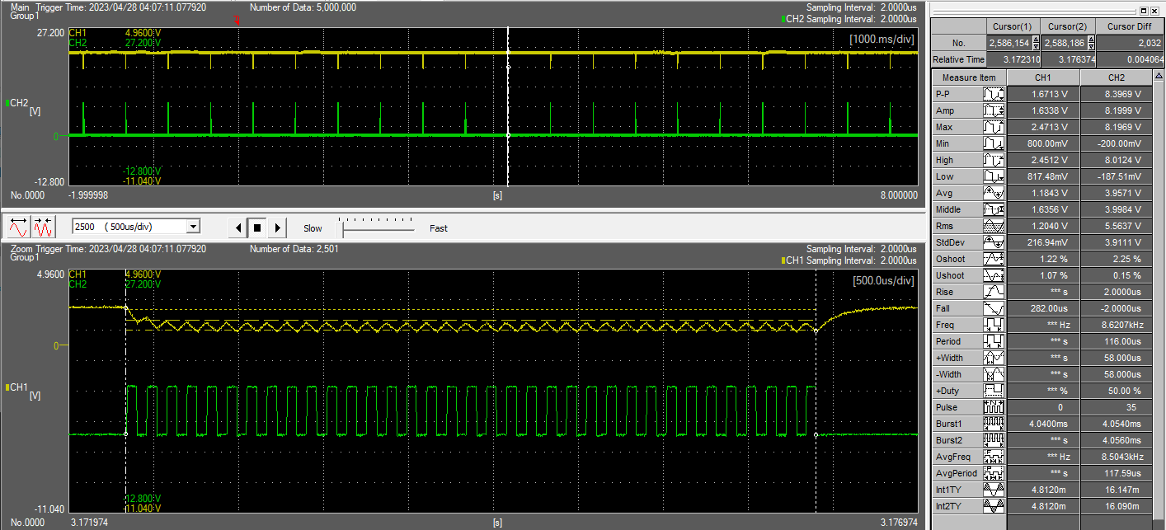
Remote Control Laser Gen 1 (Honcho) – LRU Electronics
Firmware
Detector Frequency

Slide 6
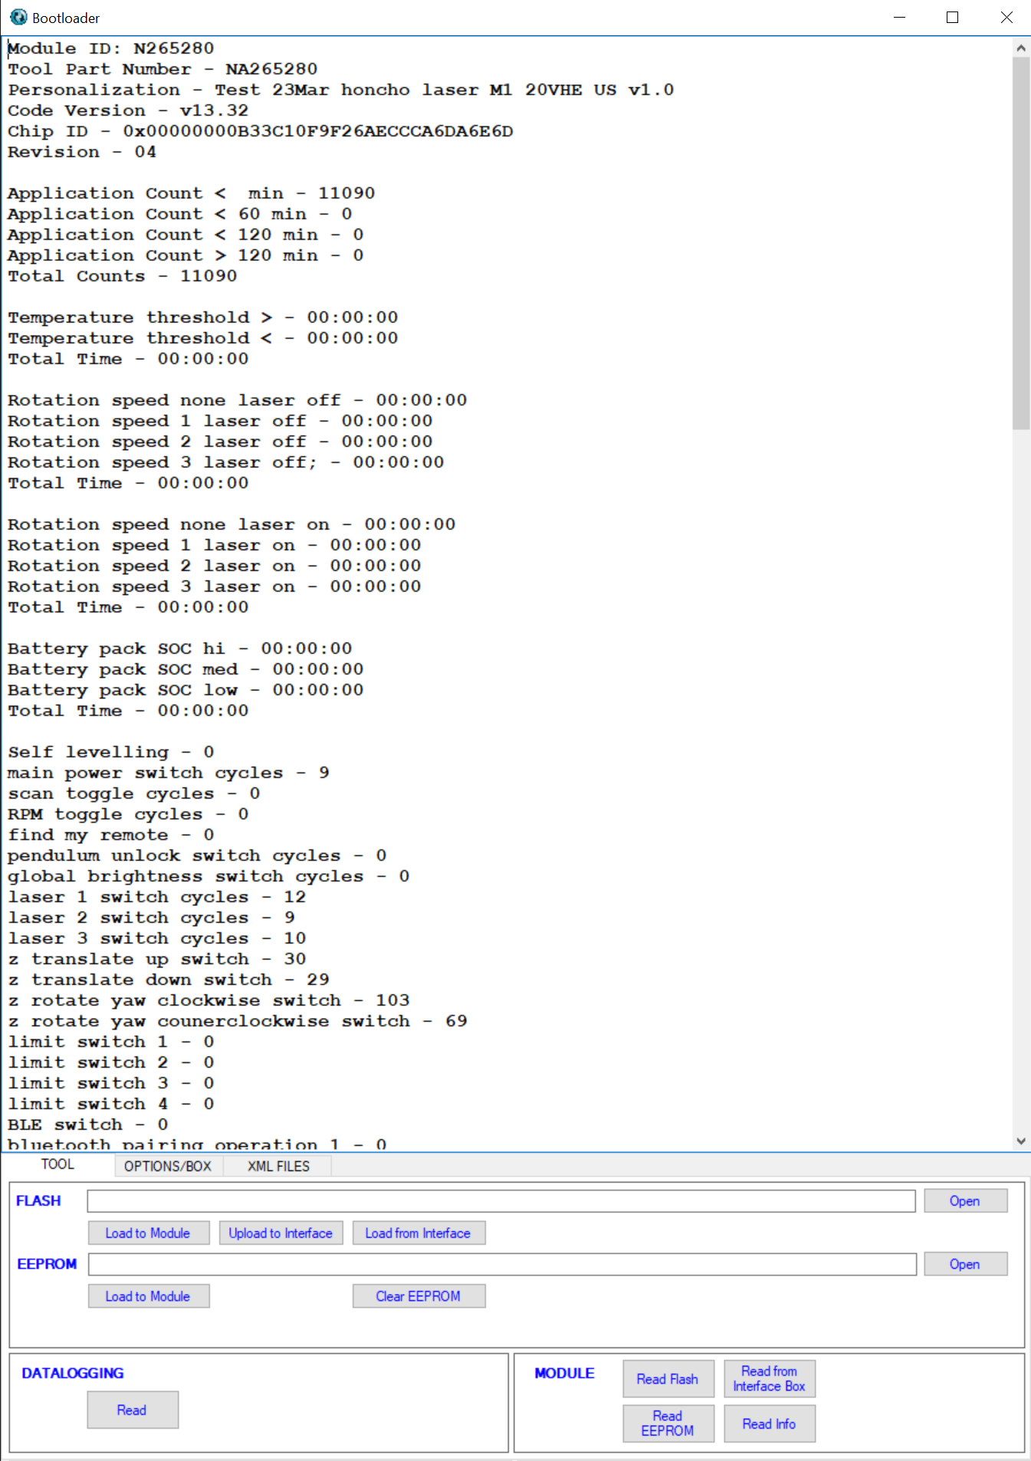
Remote Control Laser Gen 1 (Honcho) – LRU Electronics
Firmware

Slide 8
Remote Control Laser Gen 1 (Honcho) – LRU Electronics
Firmware
Challenges:
Getting IBOX compatibility with Honcho
TH and C3 must be UART and then switch to Analog pin for monitoring.
Need to figure on How to get this done on new SDK.
Power management
Need to enable deep sleep mode where Nordic is in lowest power consumption when running on Coin cell.
Accelerometer
Work still pending on accurately measuring Z-axis data for a drop/fall detection.
Enabling drop / fall detection during sleep mode.
Setting a calibration routine
Setting a calibration by setting a separate hex file for calibration for zero-point offset on accelerometer or,
Setting a calibration on very first power on and saving the zero-point point offsets.

Slide 9
PR2 to PR3 changes (as of 1 May 2023)
- Updated BLE pins to most up-to-date configuration
- Added test points
- Reversed 12-pin connector that goes to laser head (the next 3 items relate to this)
- Swapped P1 bias and P2/D1 bias pins on BLE module
- Swapped EN_P1 and EN_P2 pins on BLE module
- Swapped components used for P1 and P2 so the layout did not have to change due to the reversal of the 12-pin connector
- Added voltage divider (R75, R76, C35) to the 8V buck converter output
- Added Vsw_ADC and LASER_PS_ADC to the BLE module pins
- Moved J1 to the left and moved WAKE FETs and row resistors to the right (swapped positions)
- removed SM0 and SM1 headers for motor driver ICs
- SM0 = HIGH and SM1 = LOW for half step drive
- Moved yaw driver and supporting components and motor connector up
- Changed motor connector pins to Pin1 = 14V, Pin2 = OUT1, Pin3 = OUT2, Pin4 = OUT3, Pin5 = OUT4
- Added C40 to 3.3V LDO input to and changed C10 to 2.2uF to match C40 since a damaged C10 could have provided a direct path from B+ to GND. These are 90 degrees to each other.
- Changed J3 and J4 from TJC1255-5AWB (right angle) to TJC12519-5AB (vertical)
- Added debouncing caps C41, C42, C43, C44
- Moved J4 to the left so cables from motors would not interfere with each other.
- Moved the leftmost bottom 45 degree line 1mm to the left, dropped the leftmost leg by 1mm, and put J4 back on the leg.
- Changed J4 from vertical to RA
- Added circuits for buck converter enable that will set the minimum Vin required for turn on to 15V, while keeping control with the BLE module.
- Added 10uF bulk capacitance to BLE module 3.3V supply
- Fixed issue where coin cell holes and GND contact did not have exposed copper
- Added B+ to 12-pin connector
- Added resistors to allow adjustable LDO (fixed will still work on the same layout, if desired)

